Slide 1
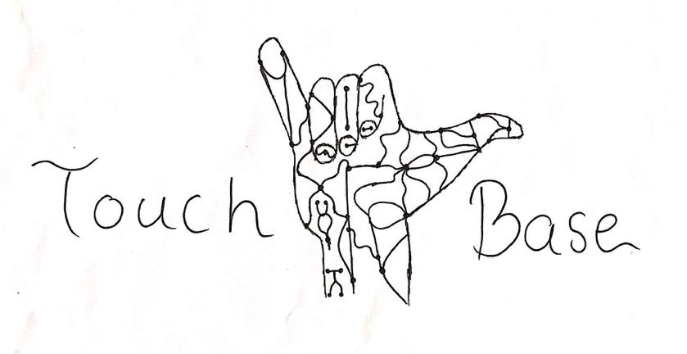
Aseel Yousef, Lihua Diao, Xiaohan Liu, Ethan Gage

Slide 2
Introduction
Project :
Adapt an existing passive prosthetic arm system to an active prosthetic arm
Progress: Most of the subsystems had been completed
Client: Dr. Winfree GTA Mentor: Demetria
Lihua

Slide 3
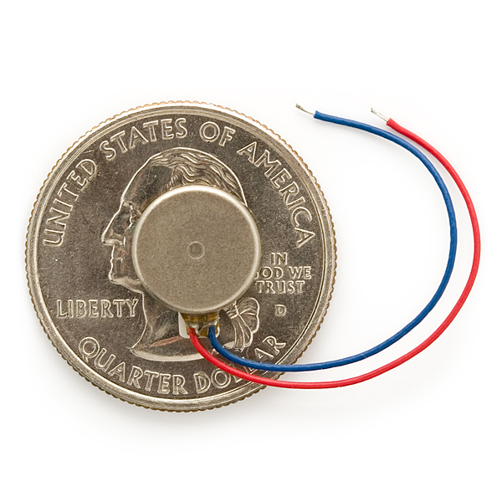
Haptic Feedback System
Why HFS is needed:
Send some mechanical input back to the user
Can let the user feel the sensation of touch
Use the vibration mini motor
Status:
Purchase vibration mini motor
Codes and circuits are in progress
What’s Next
Connect to pressure feedback system
Lihua

Slide 4
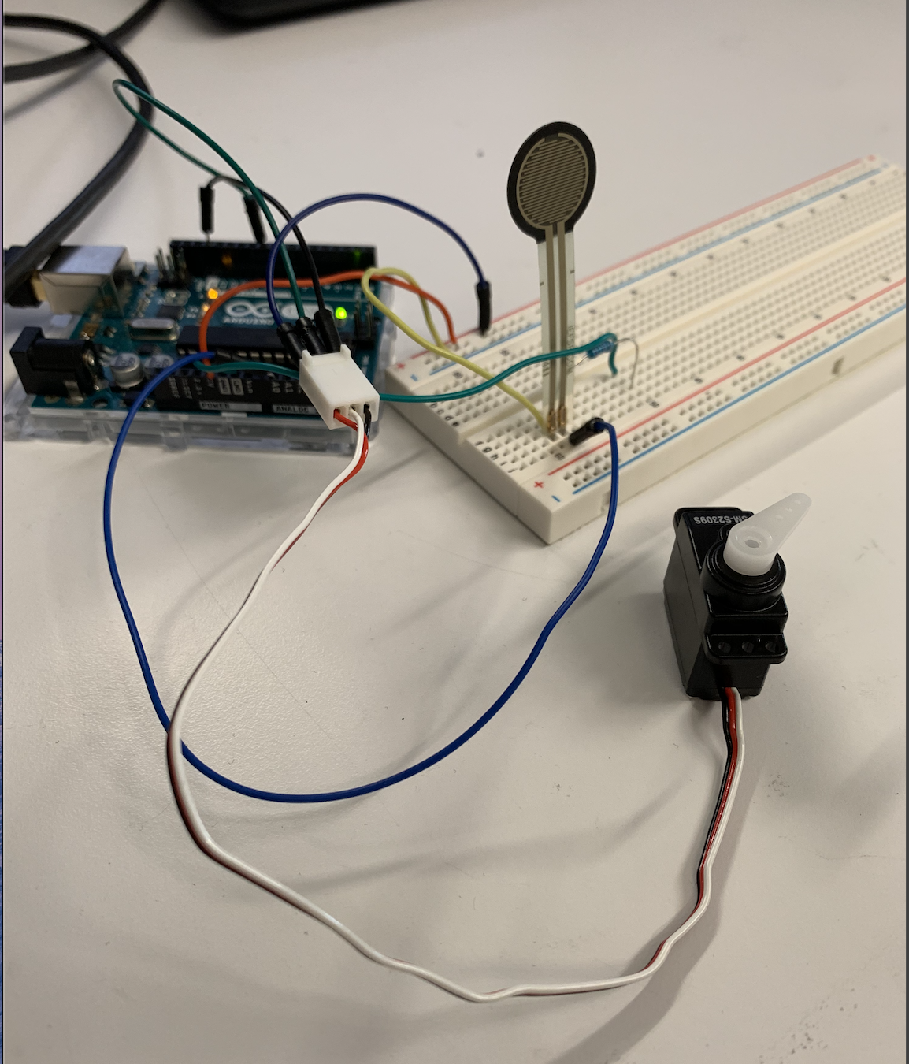
Pressure Feedback System
Servo control:
Initially used buttons to control the servo motor
Replaced the buttons with a pressure sensor
Modified the Arduino code
Status:
Code and circuit are completed
Hardware assembly is yet to be completed
What’s next:
Purchase a constricting band
Implement the system into the prosthetic device
Aseel

Slide 5
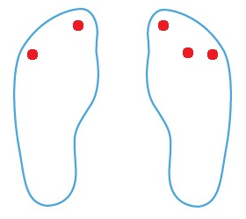
Feet-To-Hand (Previously Toe-To-Thumb)
Adaptations:
Previously 1 sensor each foot for 2 total sensors
Now 5 sensors total split 3 on dominant foot, 2 on recessive foot (figure)
Multiple control modes allow for individual finger control/complex control of hand
Progress:
Control up to three servo motors with three sensors through XBee
Hardware circuit completed with breadboards.
1 Receiver, 2 Transmitters, 5 sensors total. All on battery power
Receiver can detect which transmitter with MY XBee address.
What’s Next
Finalize code, Debug
Hard solder connections on perfboards.
Mount Sensors in insoles
Install board/servos in arm.
Ethan

Slide 6
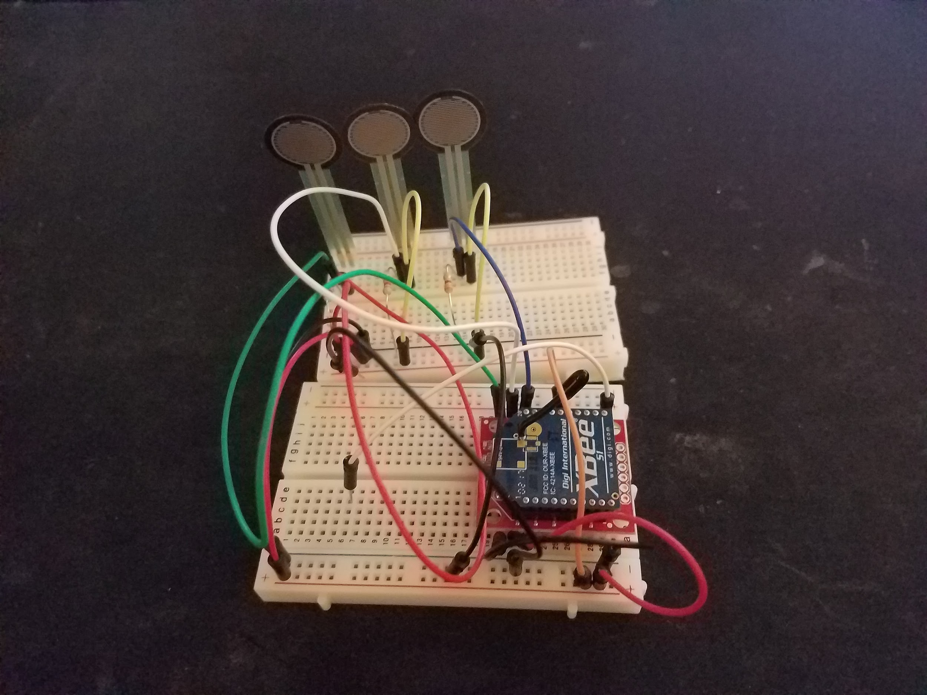
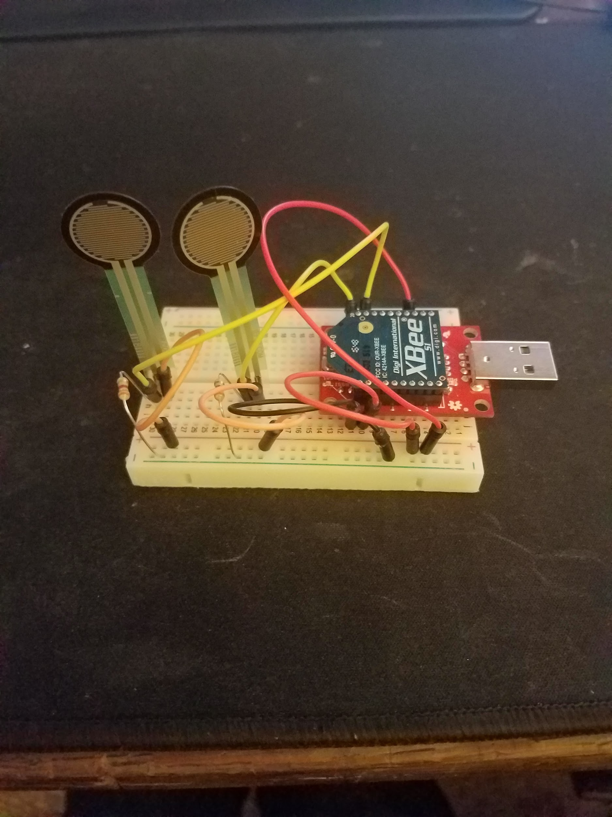
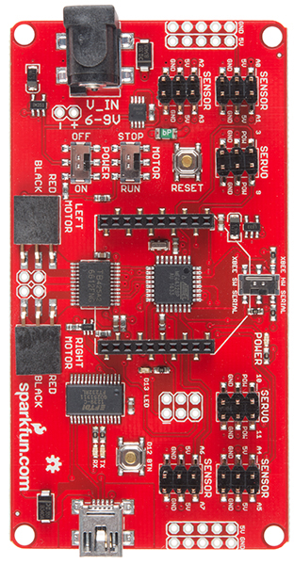
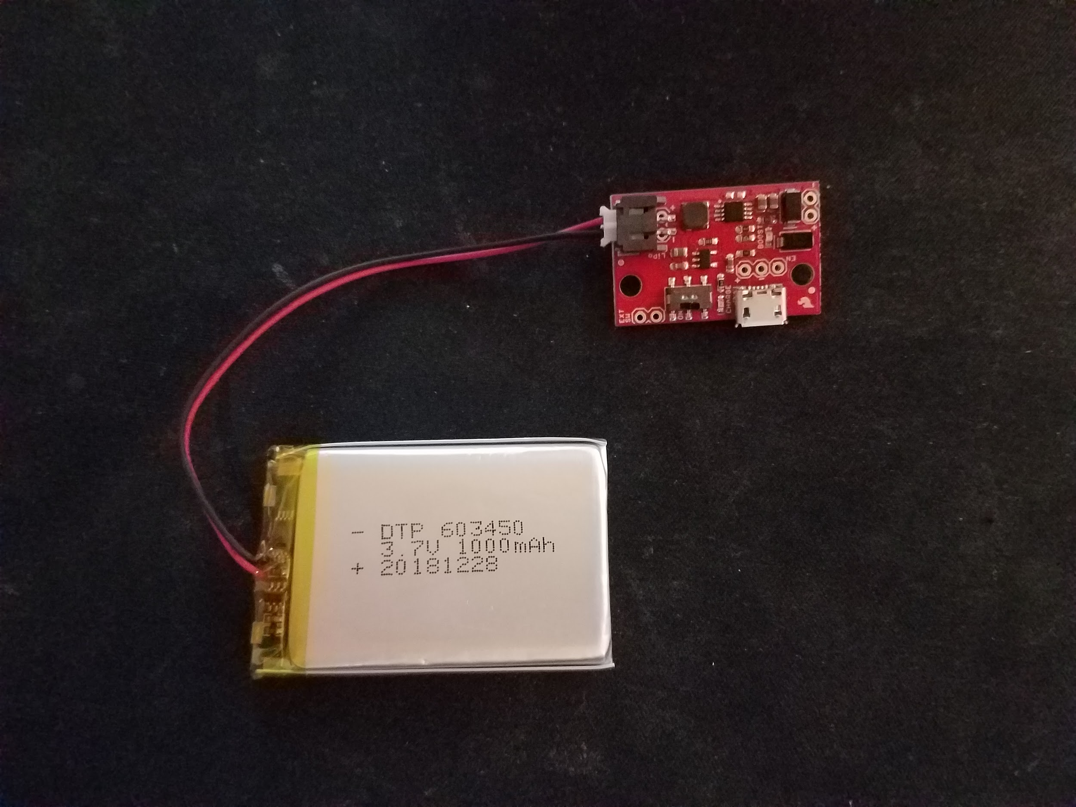
Feet-To-Hand continued….
Ethan

Slide 7
Website
Updated:
Take photos for each finished subsystems
List key milestones.
What’s Next
Attach a link to their resume under each member’s name
Collect more work details
Adjust some layouts
Xiaohan

Slide 8
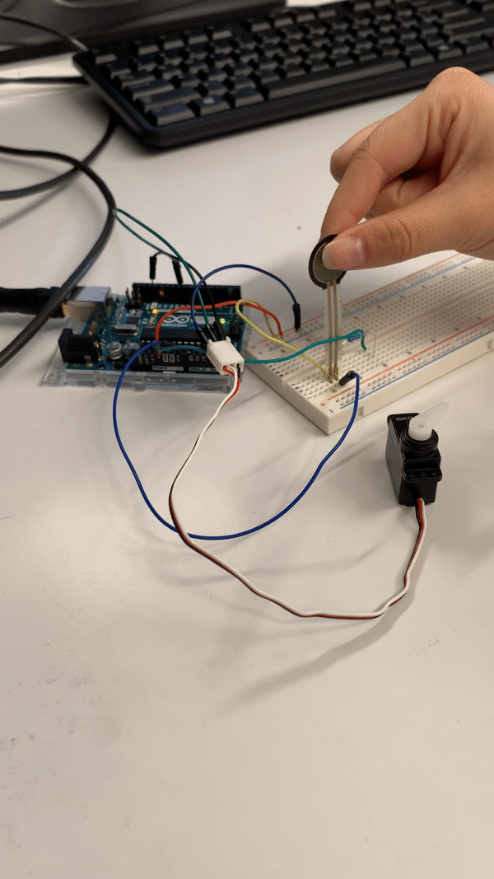
Pressure Feedback
Demonstration
Aseel

Slide 9
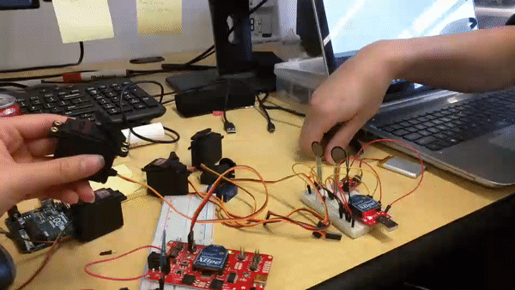
Feet-To-Hand Demonstration
Ethan

Slide 10
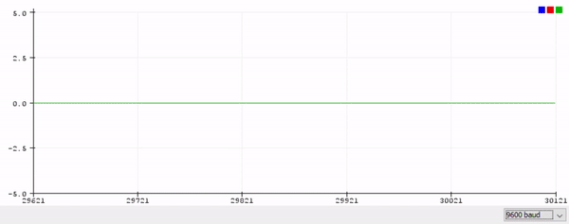
Feet-to-Hand: 3 Sensor Wireless Communication
Ethan

Slide 11
Conclusion
Progress:
Pressure feedback system has been completed.
Control three servo motors with three sensors through XBee
All required components have been received.
What’s Next:
Choose a haptic feedback system.
Integrate all subsystems on the prosthetic arm.
Xiaohan
Notes:
To sum up,

Slide 12
Questions?

Slide 13
Finish

